Slide 2
Lecture 16:Mealy Moore Machine(Finite State Transducer)
Agenda:
Mealy Machine
Moore Machine
Difference between Mealy and Moore Machine
Examples
Presented by
Prof. Vaibhav Narayan Chunekar
K. J. Somaiya College of Engineering, Vidyavihar, Mumbai

Slide 3
Finite State Transducers
FA with Output
Mealy Machine
Moore Machine

Slide 4
Moore Machine
Consist of Finite Number of States
Condition : Output Symbol at any given time depends on Current State . (i.e. Not depends on the reading current input Symbol )
Formal Definition: A moore machine is a tuple of 6 elements-
M=(Q,Σ,δ, ∆,λ,q0)
Q→ Set of States
Σ→Set of input alphabets
∆ → An output alphabets
δ →State Transition Function Q X Σ→Q
λ →Machine Function(MAF)→Q→ ∆
q0 →Initial State of the Machine

Slide 5
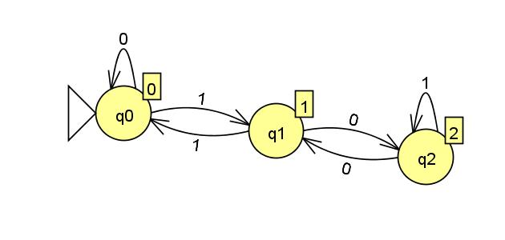
Construct Moore Machine to Find Residue –Modulo 3 for binary numbers

Slide 6
Moore Machine
Q→ {q0,q1,q2}
Σ→{0,1}
∆ → {0,1,2}
q0 →q0
δ →
λ →
Q Σ | 0 | 1
q0 | q0 | q1
q1 | q2 | q0
q2 | q1 | q2
State Q | q0 | q1 | q2
Output ∆ | 0 | 1 | 2

Slide 7
Simulation for Moore Machine
Let take String: 1010
Input: 1 0 1 0
State: q0 → q1 → q2 → q2 → q1
O/P: 0 1 2 2 1

Slide 8
Mealy Machine
Consist of Finite Number of States
Condition : Output Symbol at any given time depends on Current State of Machine and current input Symbol )
Formal Definition: A moore machine is a tuple of 6 elements-
M=(Q,Σ,δ, ∆,λ,q0)
Q→ Set of States
Σ→Set of input alphabets
∆ → An output alphabets
δ →State Transition Function Q X Σ→Q
λ →Machine Function(MAF)→Q X Σ → ∆
q0 →Initial State of the Machine

Slide 9
Construct Mealy Machine to find 2’s Compliment of given binary numbers
Logic:
Read bit by bit from Left to right(reverse order)
Keep the bits unchanged till you reach by first ‘1’ from the right side ; do not replace first one by zero . That remain unchanged well.
The remaining bits changed from 1 to 0 and vice versa.

Slide 10
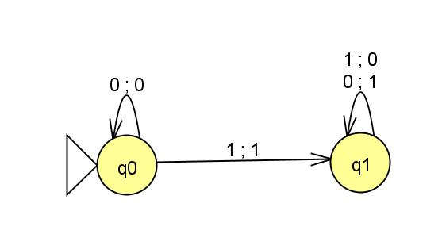
T.G Mealy Machine

Slide 11
Mealy Machine
Q→ {q0,q1}
Σ→{0,1}
∆ → {0,1}
q0 →q0
δ →
λ →
Q Σ | 0 | 1
q0 | q0 | q1
q1 | q1 | q1
State Q Σ | 0 | 1
q0 | 0 | 1
q1 | 1 | 0

Slide 12
Simulation for Mealy Machine
Let take String: 1010 (Will traverse from right to left)
Input: 1 0 1 0
State: q1 q1 q1 q0 q0
O/P : 0 1 1 0

Slide 13
Thanks!!! Any Query???

